Slide 1
Multithreading Chat Simulator
Team members :
Asfiya Rafik Goundi
Sujata
Rahul CS
Sanskriti Singh

Slide 2
Problem Statement
Real-time chat requires multiple users
Single-threaded systems cannot handle concurrency
Need to simulate simultaneous communication

Slide 3
Objectives
Simulate real time chat system
Implement multithreading
Apply OOP concepts
Handle runtime errors.

Slide 4
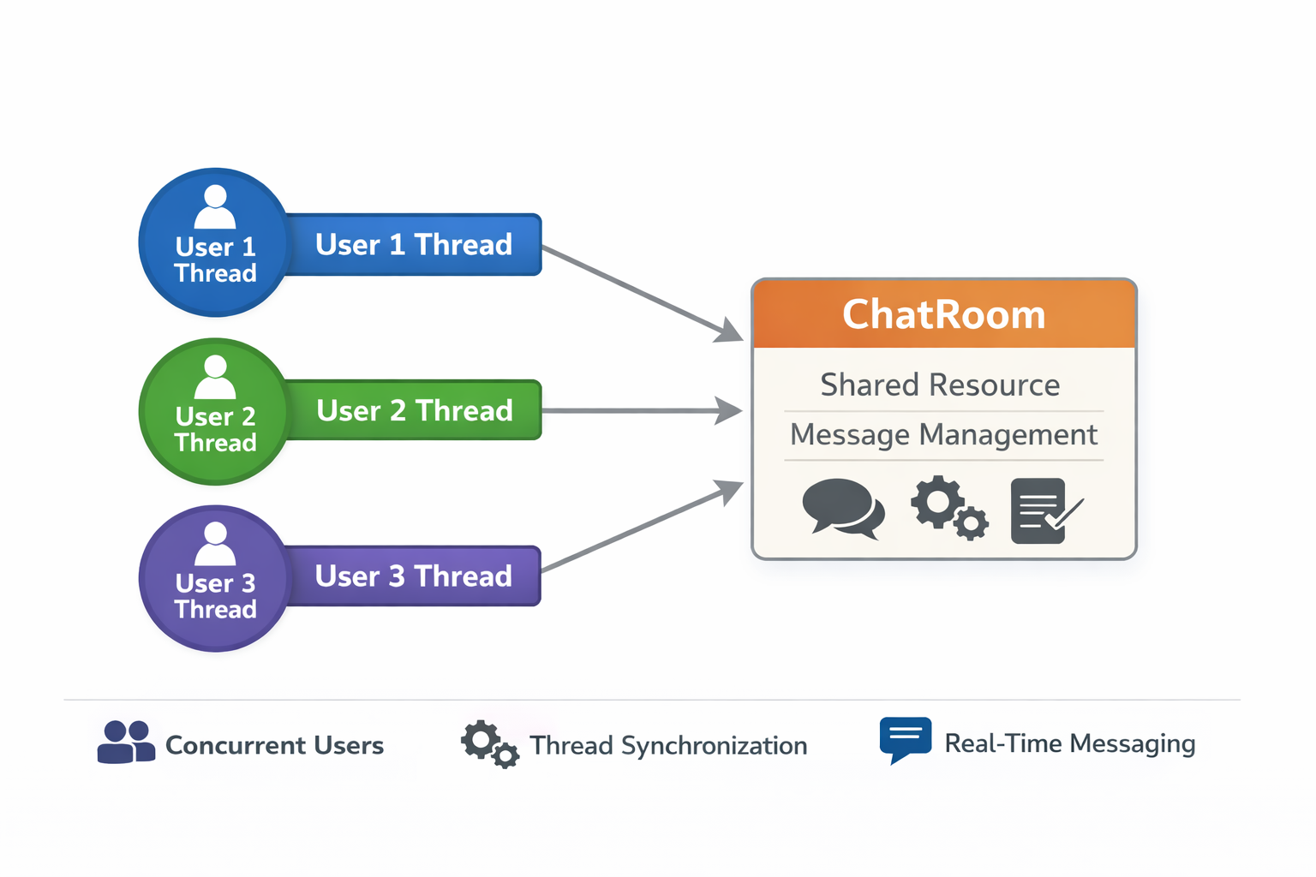
System Overview
Users → Threads
ChatRoom → Shared resource
Multiple users interact simultaneously

Slide 5
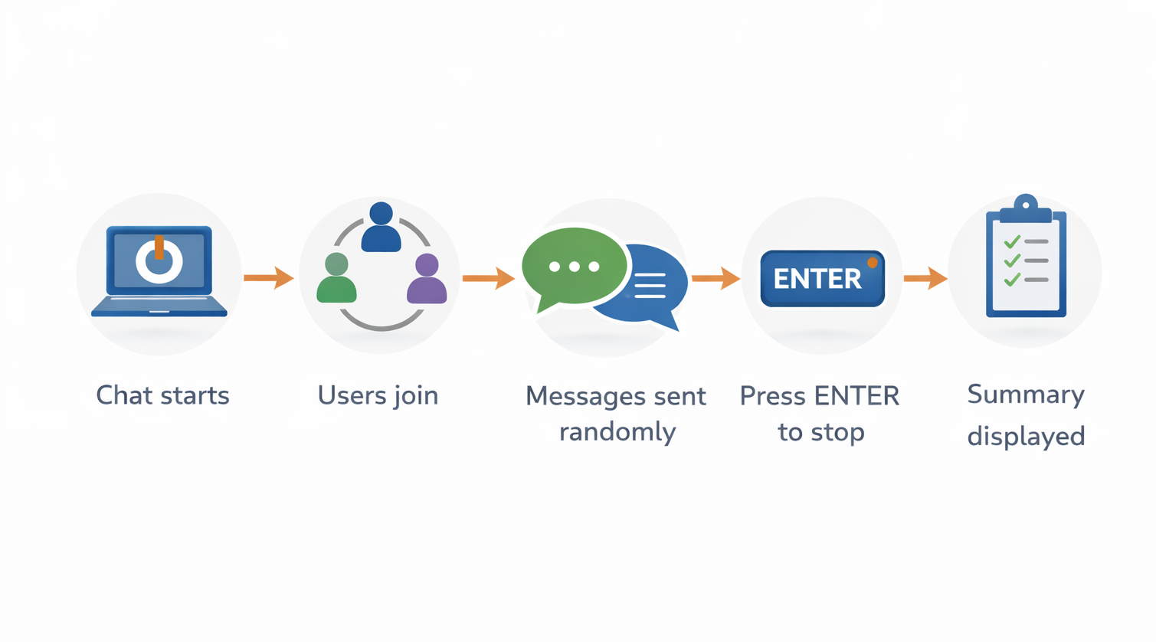
Working Flow

Slide 6
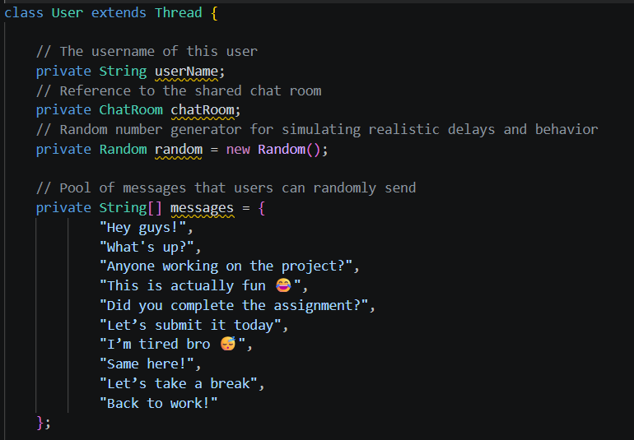
OOP
Object-Oriented Programming (OOP)
Organizes code using classes and objects & Improves structure and reusability
Used in Our Project
User → represents each user
ChatRoom → manages chat operations
ChatSimulation → main class
4 Pillars Used
Encapsulation → private data in classes
Abstraction → simple methods like sendMessage()
Inheritance → User extends Thread
Polymorphism → run() method overridden

Slide 7
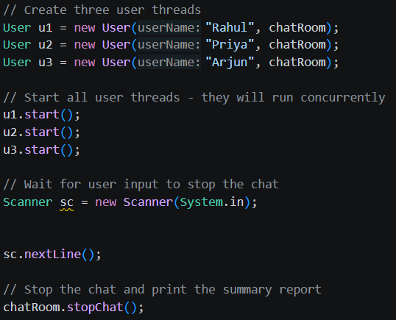
Multithreading:
Multithreading
Multiple threads run simultaneously
Each thread performs tasks independently
Used in Our Project
Each user is a separate thread
Threads run concurrently
Why We Used It
Simulates real-time chat & Allows multiple users to interact at once
How We Implemented
User class extends Thread & Threads started using .start()

Slide 8
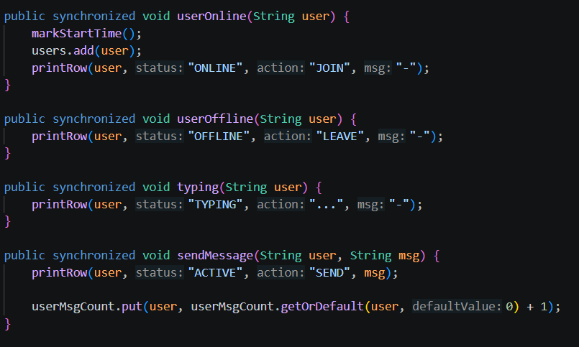
Synchronization
Synchronization
Controls access to shared resources
Prevents data conflicts
Used in Our Project
Applied in ChatRoom methods
Why We Used It
Avoids mixed or incorrect output
Ensures proper message order
How We Implemented
Used synchronized keyword in methods

Slide 9
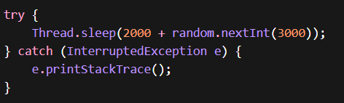
Exception Handling
Exception Handling
Handles runtime errors
Prevents program crashes
Used in Our Project
Used in thread execution
Why We Used It
To handle interruptions safely
How We Implemented
Used try-catch blocks

Slide 10
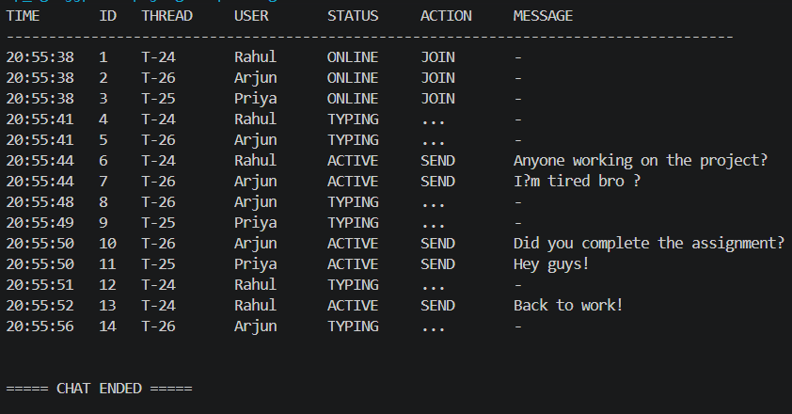
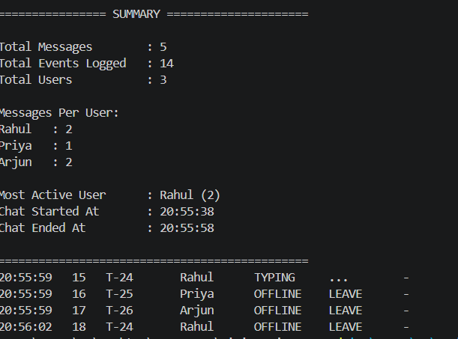
Output & Summary Features

Slide 11
Advantages
Real-time simulation
Efficient use of threads
Structured output

Slide 12
Limitations
No GUI
No real networking
No limited scalability

